Slide 1


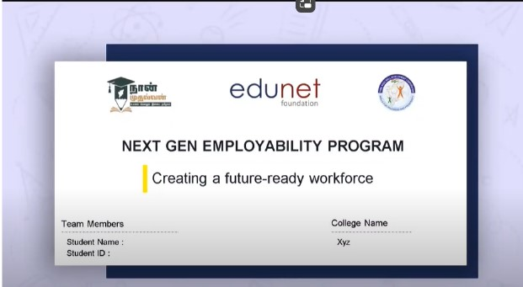
NEXT GEN EMPLOYABILITY PROGRAM
Creating a future-ready workforce
Team Members
College Name
………………………………………...............
………………………………………...............
Student Name : Ananthi G
Student ID : au613021104006
VIVEKANANDHA COLLEGE OF TECHNOLOGY FOR WOMEN

Slide 2
CAPSTONE PROJECT SHOWCASE
Project Title
Notes Sharing Web Application using Django Framework
Abstract | Problem Statement | Project Overview | Proposed Solution | Technology Used | Modelling & Results | Conclusion

Slide 3

Next Gen Employability Program
Abstract
This project aims to develop a feature-rich notes sharing web application using Python and the Django framework. Through an intuitive and customizable interface, users can create, organize, and share notes effortlessly. Leveraging advanced collaboration tools such as real-time editing and commenting, the platform facilitates interactive learning experiences and knowledge exchange. With emphasis on performance optimization and scalability, the application caters to the needs of diverse user communities, from students to professionals.

Slide 4
Next Gen Employability Program
Problem Statement
Real-Time Collaboration Feature : Integrate real-time collaboration features into the application to enable multiple users to edit and view notes simultaneously, fostering better teamwork and productivity.

Slide 5
Next Gen Employability Program
Project Overview
The proposed solution aims to develop a robust notes sharing web application using Python with the Django framework. This application will facilitate seamless sharing and collaboration on notes among users, providing a user-friendly interface and robust security measures.
Our Notes Sharing Web Application built on Python with the Django framework has laid a strong foundation for collaborative note-taking and sharing. However, to ensure its continued relevance and competitiveness in the ever-evolving landscape of digital collaboration tools, we propose several future enhancements aimed at enriching user experience, enhancing functionality, and optimizing performance.

Slide 6
Next Gen Employability Program
Proposed Solution
The proposed solution aims to develop a robust notes sharing web application using Python with the Django framework. This application will facilitate seamless sharing and collaboration on notes among users, providing a user-friendly interface and robust security measures.
Implement a secure user authentication system allowing users to sign up, log in, and manage their accounts securely.
Users can create, edit, and delete their notes. Rich text editing capabilities can be integrated to enhance the note-taking experience.
Enable users to share their notes with other users, allowing for real-time collaboration on notes. Implement features such as version control to track changes and revisions.

Slide 7
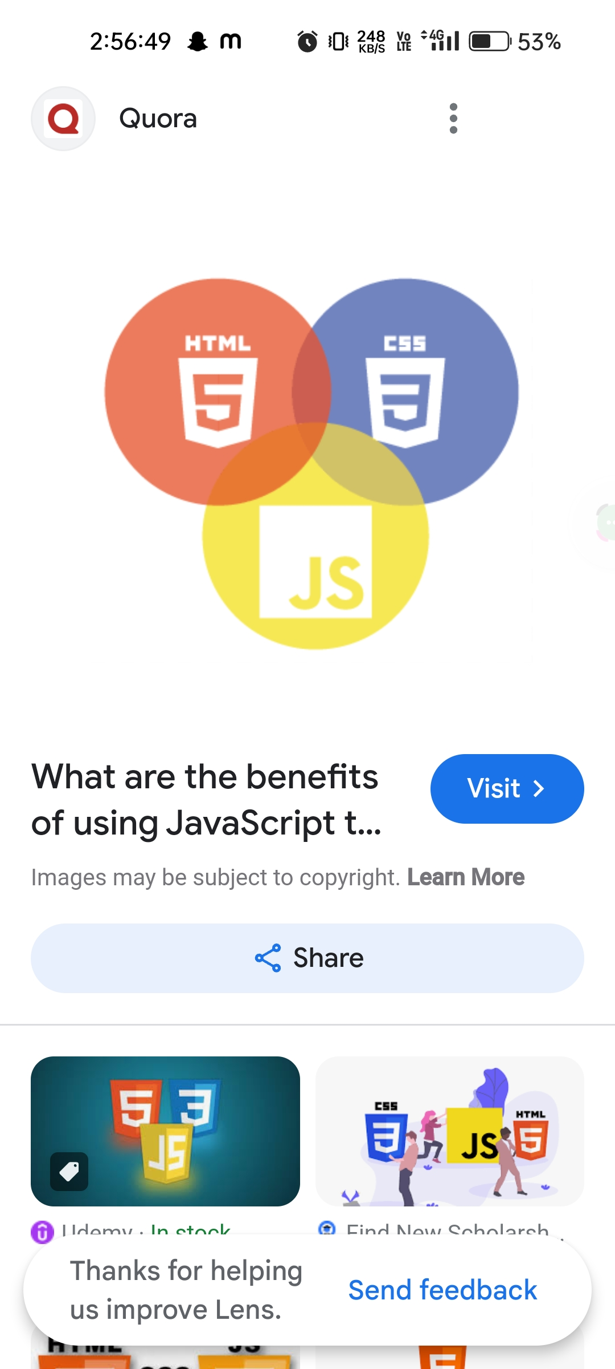

Next Gen Employability Program
Technologies Used
Frontend
Backend

Slide 8
Next Gen Employability Program
Modelling & Results
Python: Utilize Python as the primary programming language for backend development due to its simplicity, versatility, and extensive libraries.
Django Framework: Leverage the Django framework for rapid development, built-in security features, and scalability.
HTML/CSS/JavaScript: Use these technologies for frontend development to create an intuitive and interactive user interface.
SQLite/PostgreSQL: Employ SQLite during development for its simplicity and switch to PostgreSQL for production for better scalability and performance.
RESTful API: Develop a RESTful API to facilitate communication between the frontend and backend, enabling seamless integration with other platforms and services.
Results →→→ next slides

Slide 9
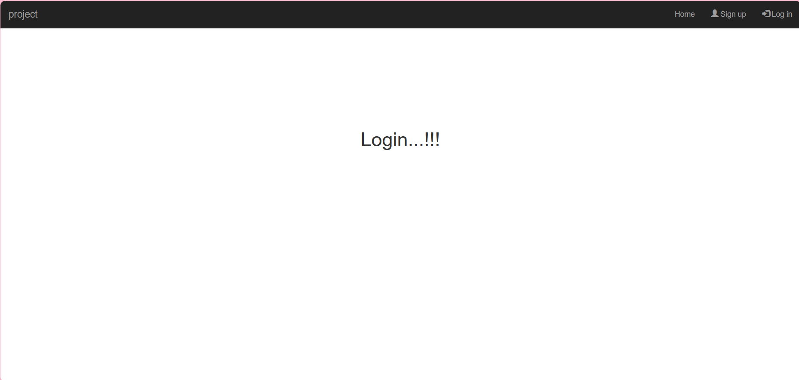
Next Gen Employability Program
Home Page

Slide 10
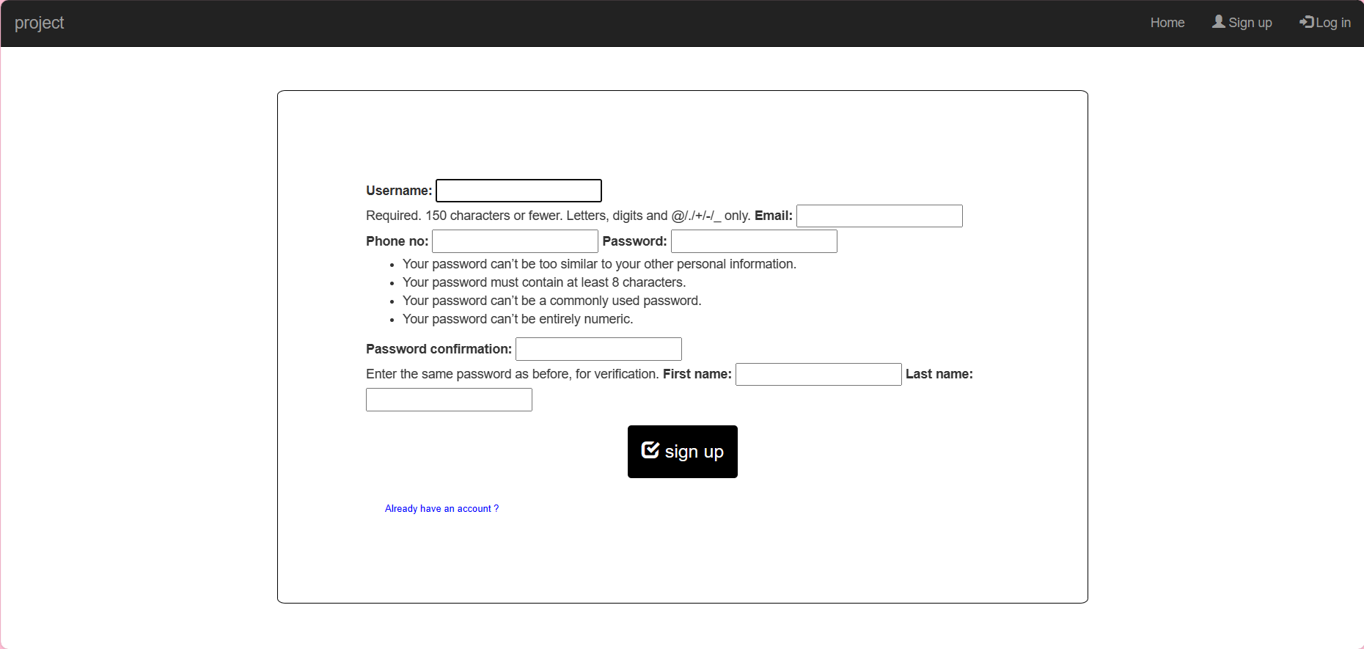
Next Gen Employability Program
SignUp Page

Slide 11
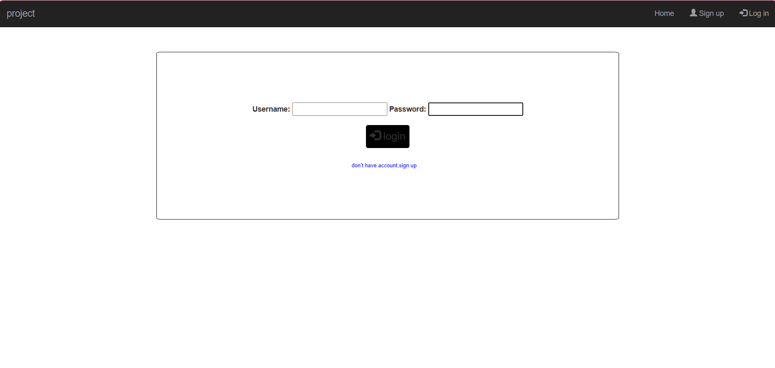
Next Gen Employability Program
Login Page

Slide 12
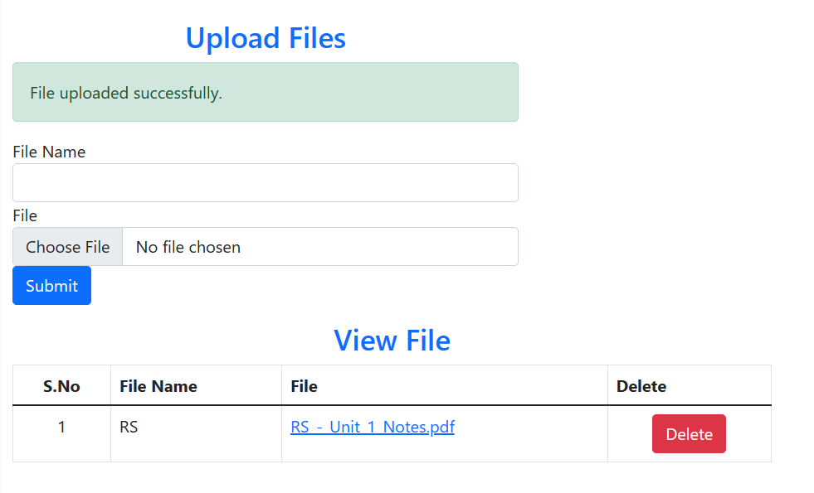
Next Gen Employability Program
Files Uploading Page

Slide 13
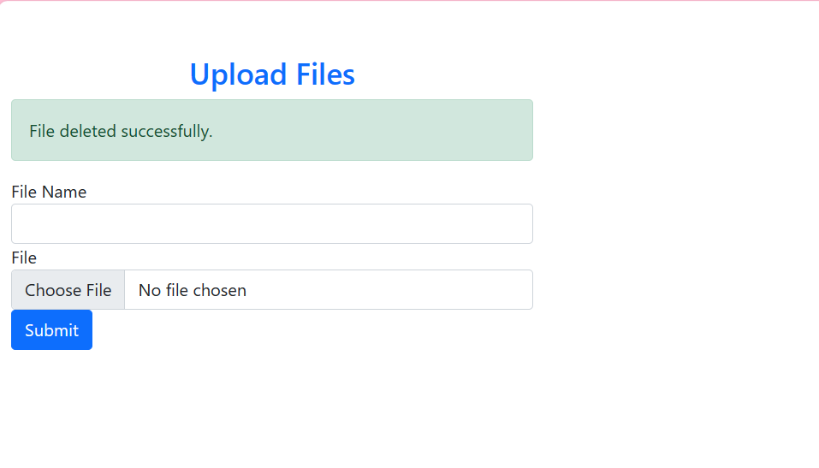
Next Gen Employability Program
Files Deleting Page

Slide 14
Next Gen Employability Program
Future Enhancements
Ensure full mobile responsiveness to provide a seamless experience across various devices and screen sizes.
Consider developing native mobile apps for iOS and Android platforms to offer a more tailored and optimized experience.
Optimize database queries, caching mechanisms, and server-side processing to improve overall application performance.
Implement lazy loading techniques to efficiently handle large volumes of notes and improve page load times.

Slide 15
Next Gen Employability Program
Conclusion
The proposed solution aims to deliver a feature-rich and scalable notes sharing web application that meets the needs of users seeking a platform for collaborative note-taking and knowledge sharing. By leveraging Python with the Django framework and following best practices in software development, the application will provide a seamless and secure user experience while enabling efficient collaboration and productivity.

Slide 16
Next Gen Employability Program
Thank You !

